Slide 1
PHASE 2 PROJECT
MEASURE ENERGY CONSUMPTION
Done by Sathya.P, Sowmiya.S ,Surya.L, Swastina.S, Vasundhra.J, Vimala devi.S

Slide 2



OVERVIEW
Problem definition and design thinking
Innovation
Development part 1
Development part 2
Documentation

Slide 3
PROBLEM DEFINITION
The problem at hand is to create an automated system that measures the energy consumption, analyzes the data, and provide visualisations for informed decision making.This solution aims to enhance efficiency ,accuracy, and ease of understanding in managing energy consumption across various sectors.

Slide 4
DESIGN THINKING
Data Source: Identify an available dataset containing energy consumption measurements.
Data Preprocessing: Clean, transform, and prepare the dataset for analysis.
Feature Extraction: Extract relevant features and metrics from the energy consumption data.
Model Development: Utilize statistical analysis to uncover trends, patterns, and anomalies in the data.
Visualization: Develop visualizations (graphs, charts) to present the energy consumption trends and insights.
Automation: Build a script that automates data collection, analysis, and visualization processes.

Slide 5
This paper proposes a data-driven modeling method for building energy consumption prediction and applies it to two actual commercial buildings. Time series analysis is adopted as a main methodology to produce the data-driven model based on monthly actual energy consumption data. The models can be used to predict building future energy consumption, after being modified and verified.

Slide 6
import pandas as p
import numpy as np
import matplotlib.pyplot as plt
import seaborn as sns
import xgboost as xgb
from sklearn.metrics import mean_squared_error
color_pal = sns.color_palette()
plt.style.use('fivethirtyeight')
df = pd.read_csv('../input/hourly-energy-consumption/PJME_hourly.csv')
df = df.set_index('Datetime')
df.index = pd.to_datetime(df.index)
df.plot(style='.',
figsize=(15, 5),
color=color_pal[0],
title='PJME Energy Use in MW')
plt.show()

Slide 7
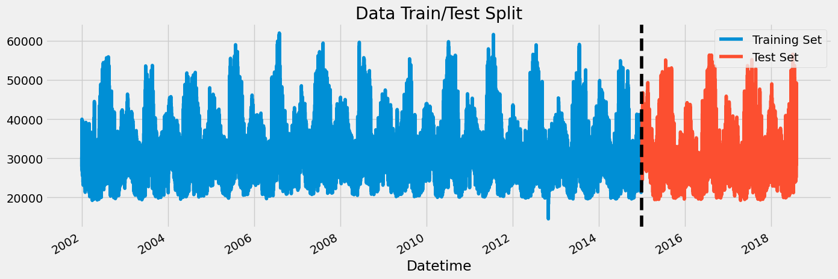
Train / Test Split
train = df.loc[df.index < '01-01-2015']
test = df.loc[df.index >= '01-01-2015']
fig, ax = plt.subplots(figsize=(15, 5))
train.plot(ax=ax, label='Training Set', title='Data Train/Test Split')
test.plot(ax=ax, label='Test Set')
ax.axvline('01-01-2015', color='black', ls='--')
ax.legend(['Training Set', 'Test Set'])
plt.show()
df.loc[(df.index > '01-01-2010') & (df.index < '01-08-2010')] \
.plot(figsize=(15, 5), title='Week Of Data')
plt.show()
Feature Creation
def create_features(df):
Create time series features based on time series index
df = df.copy()
df['hour'] = df.index.hour
df['dayofweek'] = df.index.dayofweek
df['quarter'] = df.index.quarter
df['month'] = df.index.month
df['year'] = df.index.year
df['dayofyear'] = df.index.dayofyear
df['weekofmonth'] = df.index.day
df['weekofyear'] = df.index.isocalendar().week
return df
df = create_features(df)

Slide 8
Visualize our Feature / Target Relationship
fig, ax = plt.subplots(figsize=(10, 8))
sns.boxplot(data=df, x='hour', y='PJME_MW')
ax.set_title('MW by Hour')
plt.show()
fig, ax = plt.subplots(figsize=(10, 8))
sns.boxplot(data=df, x='month', y='PJME_MW', palette='Blues')
ax.set_title('MW by Month')
plt.show()
Create our Model
train = create_features(train)
test = create_features(test)
FEATURES = ['dayofyear', 'hour', 'dayofweek', 'quarter', 'month', 'year']

Slide 9
TARGET = 'PJME_MW'
x_train = train[FEATURES]
y_train = train[TARGET]
x_test = test[FEATURES]
y_test = test[TARGET]
reg =xgb.XGBRegressor(base_score=0.5, booster='gbtree', n_estimators=1000,
early_stopping_rounds=50,
objective='reg:linear',
max_depth=3,
learning_rate=0.01)
reg.fit(x_train, y_train,
eval_set= [(x_train, y_train), (x_test, y_test)],
verbose=100)
XGBRegressor
XGBRegressor(base_score=0.5, booster='gbtree', callbacks=None,
colsample_bylevel=None, colsample_bynode=None,
colsample_bytree=None, early_stopping_rounds=50,
enable_categorical=False, eval_metric=None, feature_types=None,
gamma=None, gpu_id=None, grow_policy=None, importance_type=None,
interaction_constraints=None, learning_rate=0.01, max_bin=None,
max_cat_threshold=None, max_cat_to_onehot=None,
max_delta_step=None, max_depth=3, max_leaves=None,
min_child_weight=None, missing=nan, monotone_constraints=None,
n_estimators=1000, n_jobs=None, num_parallel_tree=None,
objective='reg:linear', predictor=None, ...)

Slide 10
Feature Importance
fi = pd.DataFrame(data=reg.feature_importances_,
index=reg.feature_names_in_,
columns=['importance'])
fi.sort_values('importance').plot(kind='barh', title='Feature Importance')
plt.show()
Forecast on Test
test['prediction'] = reg.predict(x_test)
df = df.merge(test[['prediction']], how= 'left', left_index=True, right_index=True)
ax = df[['PJME_MW']].plot(figsize=(15, 5))
df['prediction'].plot(ax=ax, style='.')
plt.legend(['Truth Data', 'Predication'])
ax.set_title('Raw Dat and Prediction')
plt.show()
ax = df.loc[(df.index > '04-01-2018') & (df.index < '04-08-2018')]['PJME_MW'] \
.plot(figsize=(15, 5), title='Week Of Data')
df.loc[(df.index > '04-01-2018') & (df.index < '04-08-2018')]['prediction'] \
.plot(style='.')
plt.legend(['Truth Data','Prediction'])
plt.show()

Slide 11
Score (RMSE)
score = np.sqrt(mean_squared_error(test['PJME_MW'], test['prediction']))
print(f'RMSE Score on Test set: {score:0.2f}')
RMSE Score on Test set: 3721.75
Calculate Error Look at the worst and best predicted days
test['error'] = np.abs(test[TARGET] - test['prediction'])
test['date'] = test.index.date
test.groupby(['date'])['error'].mean().sort_values(ascending=False).head(10)
date
Output
2016-08-13 12839.597087
2016-08-14 12780.209961
2016-09-10 11356.302979
2015-02-20 10965.982259
2016-09-09 10864.954834
2018-01-06 10506.845622
2016-08-12 10124.051595
2015-02-21 9881.803711
2015-02-16 9781.552246
2018-01-07 9739.144206

Slide 13
Thank you

